Slide 1
Machine Learning: Regression

Slide 2
Regression
Prediction of a continuous value
As opposed to classification, which is the prediction of a discrete value

Slide 3
Classification vs Regression
Classification
Will customer default on loan?
Character recognition: Which character?
Will it rain tomorrow?
Regression
Predicting house prices
Predicting temperature
Predicting crop growth

Slide 4
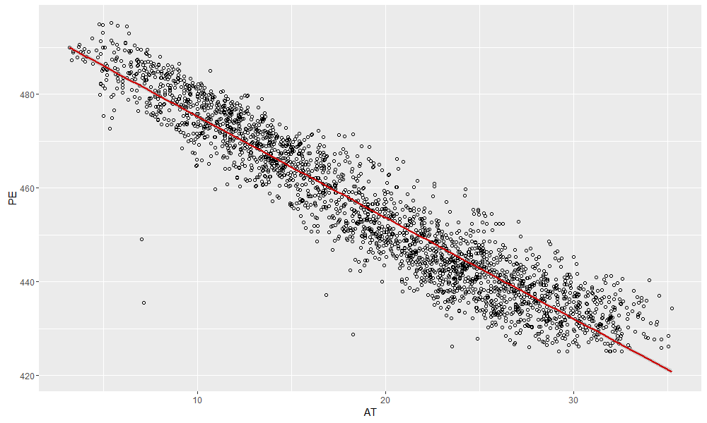
Linear Regression

Slide 5
Typical Algorithms
Linear Regression/Bayesian Linear Regression
Decision Forest
Boosted Decision Tree
Neural Network

Slide 6
More advanced features
Consider using polynomial functions of attributes
Or functions of multiple attributes

Slide 7
Overfitting
Adding more features may not improve the model
A model that fits very well to the training data may be useless for predictions
Feature selection is hard and may require a lot of trial and error

Slide 8
Overfitting

